Slide 1
Lecture 16: Introduction to Linear time-invariant filters; response of FIR filters to sinusoidal and exponential inputs: frequency response and system function Sections 4.2.2, 4.3, 4.4.1, 4.4.3 Sections 2.2.3, 2.3

Slide 2
In developing the DFT, we considered discrete-time signals which are either vectors (i.e., consisted of ﬁnitely many samples) or periodic extensions thereof. We now turn our attention to general discrete-time signals, namely sequences such as
x = x[ · ]= {x[n],n ∈ Z}
If x is a linear combination of (not necessarily periodic) sinusoids, then it also has a spectrum. Its spectrum consists of the coeﬃcients of these sinusoids given (or plotted) as a function of frequency.

Slide 3
Linear ﬁlters can be used to alter the spectra of sequences in an immediate, “real time”, fashion. A linear ﬁlter H acts as a (linear) transformation of an input sequence x to an output sequence y. (Since the input and output spaces are inﬁnite-dimensional, this linear transformation is not represented by a ﬁnite-dimensional matrix.)
y = H(x)

Slide 4
Analytically, the simplest discrete-time ﬁlter is the so-called ﬁnite impulse response (FIR) ﬁlter. At each sampling instant n, a new input sample is read in and stored in a buﬀer containing the M + 1 most recent input samples, i.e., x[n − M : n]. These samples are linearly combined using a ﬁxed vector b of coeﬃcients to produce an output sample y[n]. This procedure is described by a single formula:
y[n]= b₀x[n]+ b₁x[n − 1] + ··· + b_{M} x[n − M] ,n ∈ Z ,
known as the ﬁlter input-output relationship.

Slide 5
An FIR ﬁlter has two notable properties:
Linearity:
If three identical ﬁlters are used on input sequences x⁽¹⁾, x⁽²⁾ and x⁽³⁾ = c₁x⁽¹⁾ + c₂x⁽²⁾, then the output sequence of the third ﬁlter is the same (in terms of coeﬃcients) linear combination of the output sequences of the ﬁrst two ﬁlters, i.e., y⁽³⁾ =c₁y⁽¹⁾ + c₂y⁽²⁾
Time invariance:
If two identical ﬁlters are used on two input sequences which are time-delayed versions of each other, then the observed output sequences will also be time-delayed versions of each other (with the same delay).

Slide 6
An FIR ﬁlter modiﬁes the spectrum of an input sequence x, i.e, it changes the amounts (coeﬃcients) of the sinusoidal components of x. To illustrate this point, we take a single complex sinusoid of frequency ω:
x[n]= e^{jωn} ,n ∈ Z
and put it through a ﬁlter with coeﬃcient vector b =[1 2 2 1]^{T} .
The output sequence y is given by
y[n]= x[n]+2x[n − 1] + 2x[n − 2] + x[n − 3]
= e^{jωn} + 2e^{jω(n−1)} + 2e^{jω(n−2)} +e^{jω(n−3)}
= (1+2e^{−jω} +2e^{-j2ω}+e^{-j3ω}) e^{jωn}
= (1+2e^{−jω} +2e^{-j2ω} +e^{−j3ω}) · x[n]
Thus the output is a complex sinusoid of the same frequency; the ﬁlter merely scales the input by a complex factor which depends on the frequency ω. This is true for any FIR ﬁlter.

Slide 7
The scaling factor above is known as the frequency response of the ﬁlter and is denoted by H(e^{jω}):
H(e^{jω}) = 1+2e^{−jω} +2e^{-j2ω}+e^{-j3ω}
It is a polynomial in (negative) powers of e^{jω}. The expression for H(e^{jω}) can be simpliﬁed by noting the (non-circular) symmetry of the coeﬃcient vector
b = b_{0:3} = [1 2 2 1]^{T}
about the “middle” index 3/2. Factoring out e^{−j3ω/2}, we obtain
H(e^{jω}) = e^{−j3ω/2} (e^{j3ω/2} +2e^{jω/2} +2e^{-jω/2}+e^{-j3ω/2})
= e^{−j3ω/2} · (4 cos(ω/2) + 2cos(3ω/2))

Slide 8
The modulus |H(e^{jω})| of the frequency response is known as the amplitude, or magnitude, response of the ﬁlter. In this case, noting that |e^{jθ}| = 1, we have
|H(e^{jω})| = |4 cos(ω/2) + 2cos(3ω/2)|
This function of ω is symmetric about ω = π and has three zeros in the interval [0, 2π): at ω =2π/3, π and 4π/3. Thus for any of the three input sequences
x⁽¹⁾[n]=e^{j2πn/3} , x⁽²⁾[n]=(−1)^{n}, x⁽³⁾[n]=e^{j4πn/3} ,n ∈ Z,
the ﬁlter output equals 0 for all n. By linearity, the same is true about any linear combination of these three input sequences; in particular, the sequence x[n] = cos(2πn/3+φ₀). Why?
This means that those frequencies have been filtered from the original input

Slide 9
The angle ∠H(e^{jω}) of the frequency response is known as the phase response of the ﬁlter. In this case, recalling that ∠z₁z₂ = ∠z₁ + ∠z₂, we have
∠H(e^{jω})= −(3ω/2) + ∠ (4 cos(ω/2) + 2cos(3ω/2))
The ﬁrst term is linear in ω, while the second equals 0 or ±π, depending on whether the real number 4 cos(ω/2) + 2cos(3ω/2) is positive or negative. This means that ∠H(e^{jω}) is piecewise linear with constant slope (= −3/2) and discontinuities of size π occurring wherever 4 cos(ω/2) + 2cos(3ω/2) changes sign, i.e., at ω =2π/3, ω = π and ω =4π/3.
Note: The phase response ∠H(e^{jω}) is piecewise linear for all FIR ﬁlters whose coeﬃcients have even or odd symmetry about the middle index (M/2).

Slide 10
The expression for the frequency response H(e^{jω}) is always periodic with period (in ω) equal to 2π; as a result, H(e^{jω}) is (automatically) periodically extended outside the interval [0, 2π).
The amplitude response |H(e^{jω})| is symmetric (even) about ω = 0 and π, while the phase response ∠H(e^{jω}) is antisymmetric (odd) about the same frequencies. This is true for all FIR ﬁlters with real-valued coeﬃcients b₀,...,b_{M} , since
H(e ^{jω})= b₀ + b₁e^{-jω} + ··· + b_{M} e^{-jωM}
and
H(e^{-jω})= H(e^{j(2π-ω)})= b₀ + b₁e^{jω} + ··· + b_{M} e^{jωM} = H∗(e^{jω})
(Recall that |z ∗| = |z| and ∠z* = −∠z.)

Slide 11
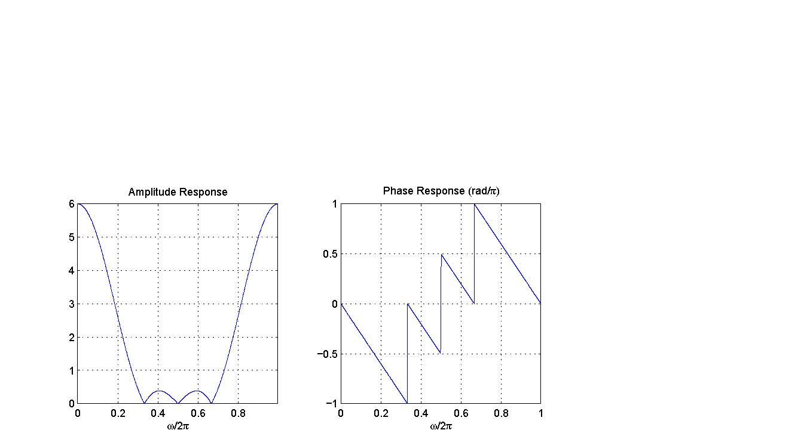
Plotting |H(e^{jω})| and ∠H(e^{jω}) requires computing H(e^{jω}) at a suﬃciently dense set of frequencies ω in [0, 2π), i.e.,
ω = 0, 2π/N, 4π/N , . . . , 1 − 2π/N, where N >> M
These are the Fourier frequencies for a vector of length N. Provided N ≥ M +1, the resulting vector of values of H(e^{jω}) equals the DFT of
[b ; 0_{N−M−1}]

Slide 12
Example
The following MATLAB script computes the amplitude and phase responses of the FIR ﬁlter with input-output relationship
y[n]= x[n]+2x[n − 1] + 2x[n − 2] + x[n − 3]
at N = 512 uniformly spaced frequencies in [0, 2π).
b=[1 2 2 1].’ ;
H = fft(b,512) ;
A = abs(H) ; % amplitude response
q = angle(H) ; %
phase response
w = (0: 1/512 : 1-1/512).’*(2*pi) ; plot(w,A) ; plot(w,q) ;

Slide 13
Similar conclusions can be drawn when the input signal is a complex exponential, i.e.,
x[n]= z^{n}, n ∈ Z
where z is an arbitrary complex number. Using the same ﬁlter as previously, we have, for all n,
n−2 _{+ z} n−3
y[n]= z^{n} +2z^{n−1} + 2z^{n−2} + z^{n−3}
= (1+2z⁻¹ +2z⁻² + z⁻³) z^{n}
= (1+2z⁻¹ +2z⁻² + z⁻³) x[n]
The complex scaling factor
H(z) = 1+2z⁻¹ +2z⁻² + z⁻³
is known as the system function of the ﬁlter. The frequency response H(e^{jω}) of an FIR ﬁlter is the restriction of its system function to the unit circle z = e^{jω}.

Slide 14
Problems: 4.2, 4.4

