Slide 1
Engineering Student Clubs
Uche abanulo

Slide 2
LIst of Clubs
AeroSpace Club
ASME MC Student Branch
Astronomy Club
Engineering Without Borders (EWB)
IEEE MC Student Branch
MC Engineering Club
Robotics Club
Women in Engineering Science and Technology (WEST)

Slide 3
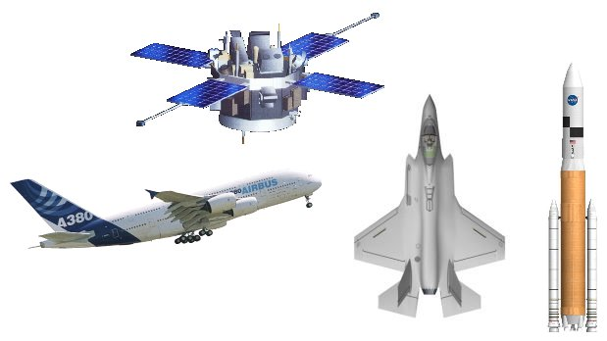
Aerospace Club
Club Contact
Hands-on experience in
aerospace simulation
model building of interactive drones, aeroplanes, rockets etc.
Affiliation with profesional societies:
The American Institute of Aeronautics and Astronautics and
The Experimental Aircraft Association (EAA)
Faculty Advisor: Dr. Mohibullah N. Durrani
Email: Mohibullah.Durrani@montgomerycollege.edu
Club President: Tuan Quach

Slide 4
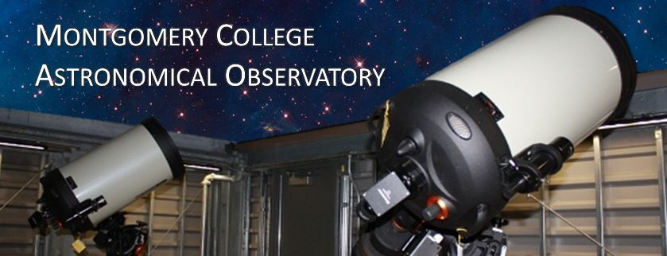
Astronomy (Star-Gazers) Club
Club Contact
Students interested in observational astronomy.
Spend time learning how to use the college's telescopes as well as instrumentation for astrophotography.
Astronomy course not needed to be part of the club.
Activities:
Participation in observatory guest nights
Education and public outreach including solar observing and special astronomical events
Faculty Advisor: Dr. Carrie Fitzgerald
Email: college.edu
Faculty Advisor: Dr. Carrie Fitzgerald
Email: Carrie.Fitzgerald@montgomerycollege.edu

Slide 5
Engineers without borders
Club Contact
Partner with disadvantaged communities in developing countries through the implementation of sustainable engineering projects, while seeking to train internationally responsible engineering students.
Activities:
We are the only community college with a full chapter in EWB-USA.
Several activities each semester.
check out website for more info
Website: http://www.montgomerycollege.edu/Departments/ewbmc/
Faculty Advisor: Prof. Craig T. Garrison-Mogren
Email: craig.mogren@montgomerycollege.edu

Slide 6
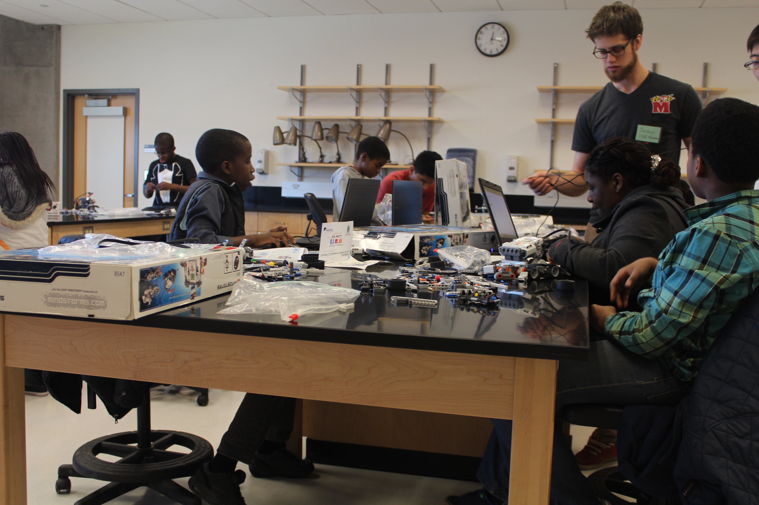
IEEE
Club Contact
Premier professional organization for engineers of all fields.
Mission of the IEEE MC student branch is to provide a gateway for prospective engineers at MC become part of an international engineering community as well as gain invaluable knowledge and experience.
Activities:
Weekly engineering and technology workshops year-round
Participation in IEEE Seminars and conferences
Participation in robotics and other engineering competitions nationwide
K-14 STEM Outreach
Faculty Advisor: Dr. Uche Abanulo
Email: uche.abanulo@montgomerycollege.edu

Slide 7
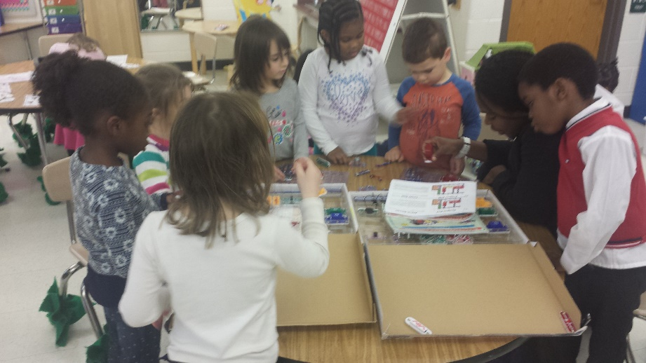
MC Engineering Club
Club Contact
Mission:
To provide an exciting learning environment that promotes the love for and interest in engineering related subjects.
Activities:
engineering seminars and hands-on workshops during the fall and spring semesters
Field trips to well-known engineering institutions
K-12 outreach @ MCPS elementary and middle schools
Faculty Advisor: Dr. Uche Abanulo
Email: uche.abanulo@montgomerycollege.edu

Slide 8
Robotics Club
Club Contact
Mission:
To provide its members with an opportunity to gain experience in order to successfully design and build a functional robot.
Club members must work with a diverse group of people, plan ahead, work on a budget, deal with deadlines and learn to use and implement new technology.
In order to see a project to completion, members must also learn to deal with any problems as they arise without becoming discouraged and giving up.
Activities:
Participation in robotics competitions nationwide
Summer sports/outdoor activities
Faculty Advisor: Dr. Alex Hou
Email: ChienannAlex.Hou@montgomerycollege.edu

Slide 9
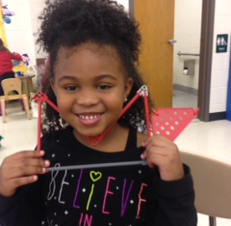
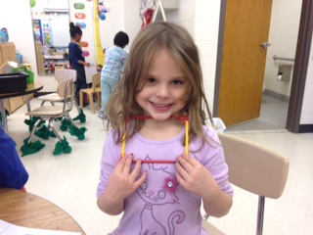
Women in Engineering, Science and technology
Club Contact
Mission:
to increase the participation of women in science and engineering-related careers.
Activities:
Guest speeches by highly successful female scientist and engineers to encourage and mentor up-coming students who indicate interest in such careers.
engineering workshops that attract women to the field of engineering.
Field trips to well-known engineering institutions
K-12 outreach @ MCPS elementary and middle schools
Faculty Advisor: Dr. Uche Abanulo
Email: uche.abanulo@montgomerycollege.edu

Slide 10
NSF S-STEM Scholarship
Uche abanulo

Slide 11
Summary
Up to $3600/year according to need indicated on FAFSA form
Eligibility
Must be a citizen/permanent resident
Must be an enrolled at MC for Engineering or Computer Science
Support
Transfer advising
Transfer financial aid assistance
Experiential learning (internship/REU placement), outreach
Career advising
College Trips
Faculty and peer mentoring
To apply, please visit the scholarship webpage:
http://cms.montgomerycollege.edu/ACCESS_II/

